Slide 1

Project 3
Development of Electronic Payment System Using Smart Contracts
By Luis Lu, Damien Nyugen and John Bilsel

Slide 2

Aim: To develop a payment smart contract to facilitate (and record) each transaction of money transfer.

Slide 3




A simple example:
Sam owns a shop and wants a transparent payment system.
He therefore requires those buying from his shop to exchange (buy) the token “DLJ” with a fiat currency on his platform.
This allows him to very transparently see the transactions on the smart contract when he swaps the “AUD” for example for DLJ token.
The buyer can then use that token to purchase anything on the website.
The DLJ token is pegged to the AUD, hence being labelled a “stable-coin”.

Slide 4
Process 1. Establish the parties for the transactions. We set up two parties for each transaction contract. One is the seller, the other is the buyer. Contract conditions: a) Contract must have gas fee and charge fee for each transaction. b) The contract needs to allow both buyer and seller to enter their wallet account address for transferring or saving money. 2. Using the developed stable-coin “DLJ” (pegged to AUD), we can make the transaction and help shop owner X with his business in a transparent way. 3. You can use the stream lit exchange dashboard to check to active AUD exchange rates!

Slide 5
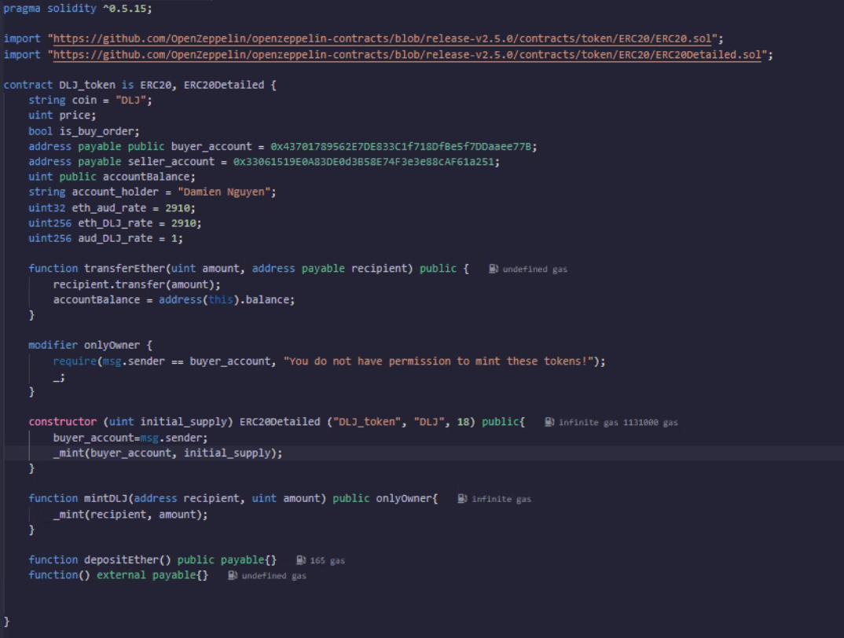

Solidity Establishment:

Slide 6
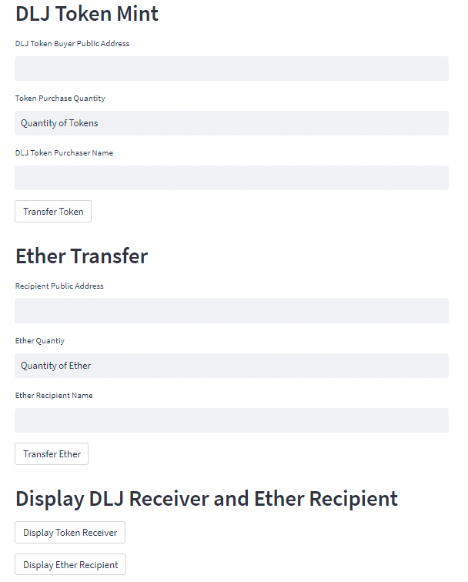


(2) Making Transactions (Streamlit, py)

Slide 7
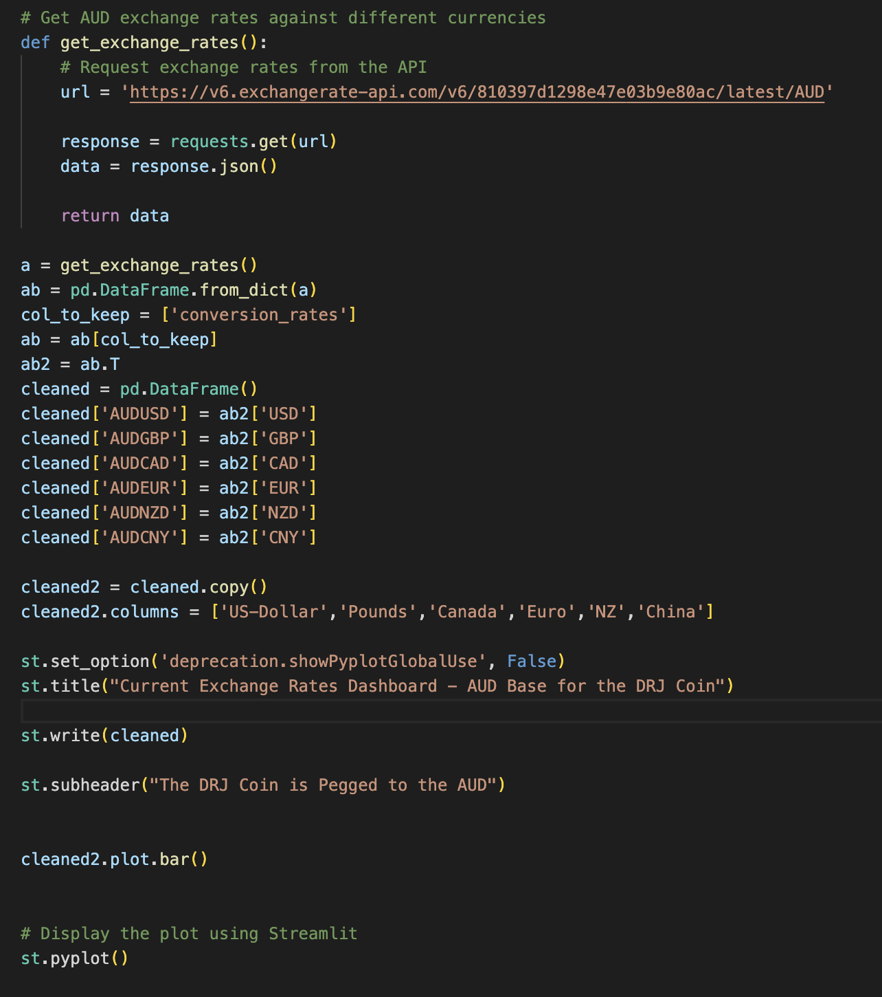
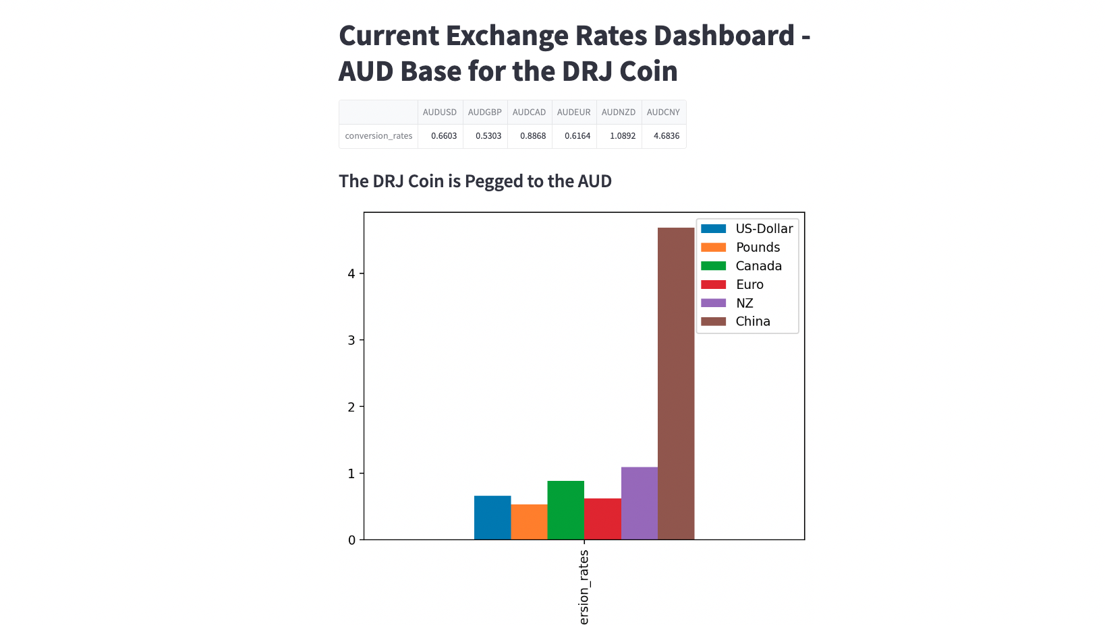
(3) Real-Time Exchange Rate Dashboard (Streamlit, py)

Slide 8
Conclusion: Using smart contracts, shop owners can easily access a decentralized and transparent system which can track the transactions across their orders.

